Slide 1
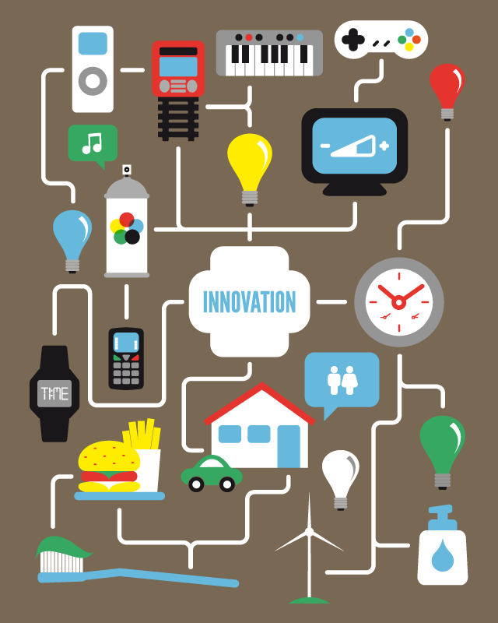
IM_06
Digital Transformation

Slide 2

Index
What is Digital Transformation?
Technology and digital transformation
Smart everything
What role for human beings in Digital Transformation?
The future of jobs
The transformation of users

Slide 3
1. What is Digital Transformation?
Digital transformation is often viewed as an implementation of digital technologies into all areas of business in order to build more sustainable relationships and better understand the needs of customers. But this is just one of the ways to look at it.
Digital transformation is the process of using digital technologies to create new or modify existing business processes, culture, and customer experiences to meet changing business and market requirements. It is an unavoidable and necessary step for the subsistence and evolution of any company.
The promise of digitization is a new industrial revolution comparable to what was supposed to be the steam engine or computers. It can be defined as “Revolution”, because it has a transversal impact in all sectors of the economy and society. In the way electricity played a central role in the traditional economy, we now are seeing how many activities, businesses and society in general is going digital.
This 4th industrial Revolution has been facilitated by a series of technologies such as artificial intelligence, Internet of Things, and robotics, interconnected to transform the consumer experience and with it the business models. A change we can already observe when using voice commands, in autonomous cars and smart devices that keep us always connected

Slide 4
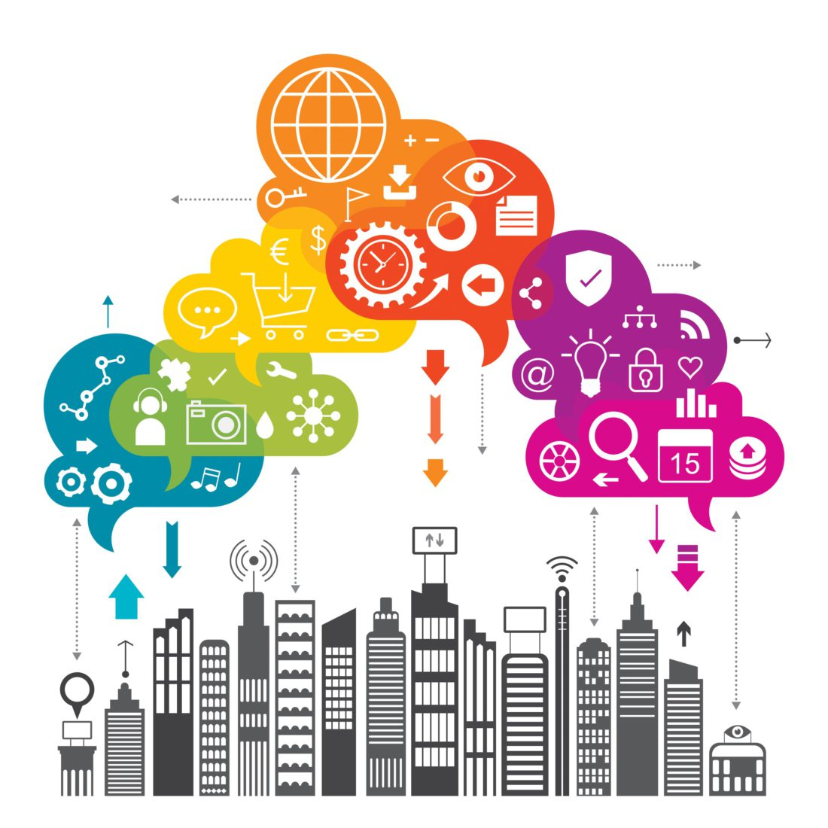
1. What is Digital Transformation?
In the case of companies, the most difficult thing to do, but also the one that will differentiate them from competitor, is creating a new culture and rethinking business processes, especially those related to the customer, because technology is shifting the center of gravity from businesses to consumers
Digitized companies are 10% more productive, export twice and create twice as many jobs than companies that have not addressed their digital transformation. In fact, it is estimated that 40% of the latter will disappear
A good use of digital technology can contribute not only to economic growth but also achieve great social and environmental benefits as in the case of remotely monitoring chronic patients and the elderly, helping to alleviate family pressure, intelligent transport that reduces traffic jams, accidents and the use of energy, education systems, training of workers, smart cities, etc.

Slide 5
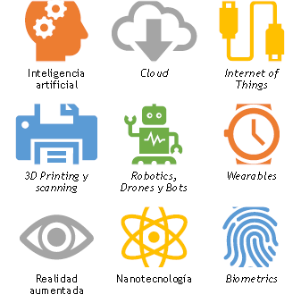
2. Technology and digital transformation
Throughout history, economies that have been able to adapt to new technologies are the ones that have survived the changes more successfully. The rapid spread of Internet connectivity from the 1990s is at the origin of the current digital revolution and the interconnection of a series of disruptive technologies that have transformed user habits and business models.
The nine technologies in the illustration, that have been selected based on factors such as their impact on business, maturity and growth, are transforming or will transform businesses in the next years
In the following slides, some other technologies that are already transforming not only the economy, but also the ESG landscape.

Slide 6
Nanotechnology. When the size of any material is reduced, its qualities and properties can be altered, leading to new uses and functionalities that didn't previously exist. In addition, miniaturization allows advances in fields as sensitive as health, the military or manufacturing.
AR/VR/MR.
Wearables are devices integrated or attached to some part of the body or clothing that generate data by continuously interacting with the user and other devices. Amongst their main challenges: Fragmentation, Security and Privacy.
Biometrics. The logical achievement of wearables is the quantification of the user, by transforming our lives (habits, health, etc.) into a succession of measurable events that allow us to generate multiple insights. From the correlation between lifestyle and diseases of all kinds to increasing adherence to treatments or serving as a guide to improve user experiences.

Slide 7
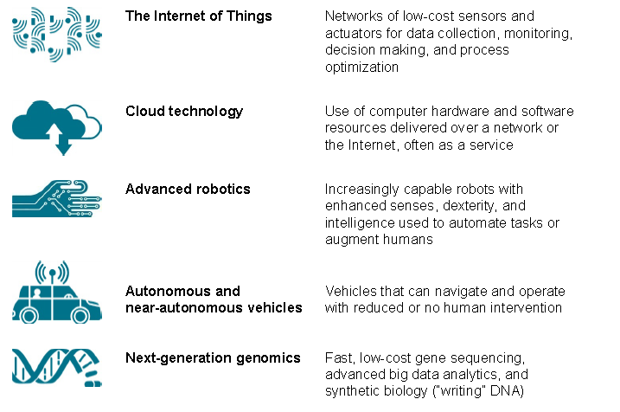
2. Technology and digital transformation

Slide 8
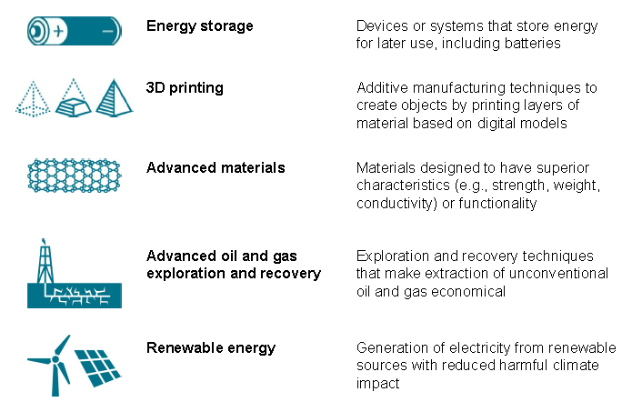
2. Technology and digital transformation

Slide 9
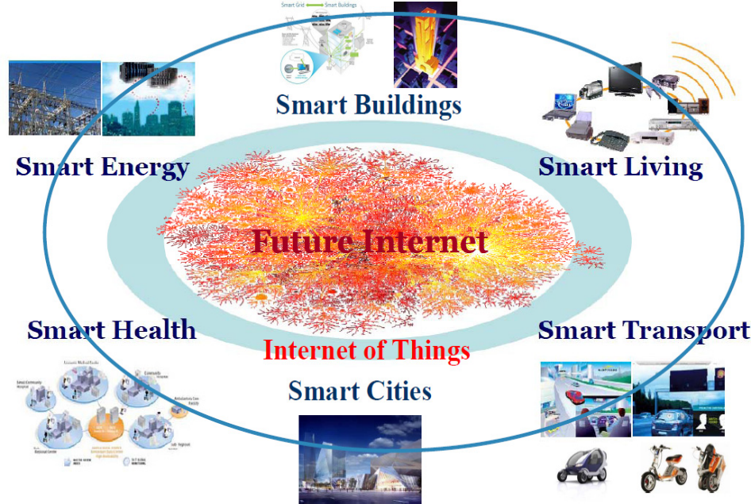
3. Smart everything….
A concept closely related to the IoT is “smart" applied to various social and human activities.
It is based on the idea of using all the information generated by the IoT to improve our lifestyle, the way we live, the way we move or simply take care of our health.
This concept not only refers to the business field, but also covers many other activities.
In the future, the huge amount of information generated through the Internet will serve to make a more rational use of resources, and to improve the human experience from a global point of view.

Slide 10
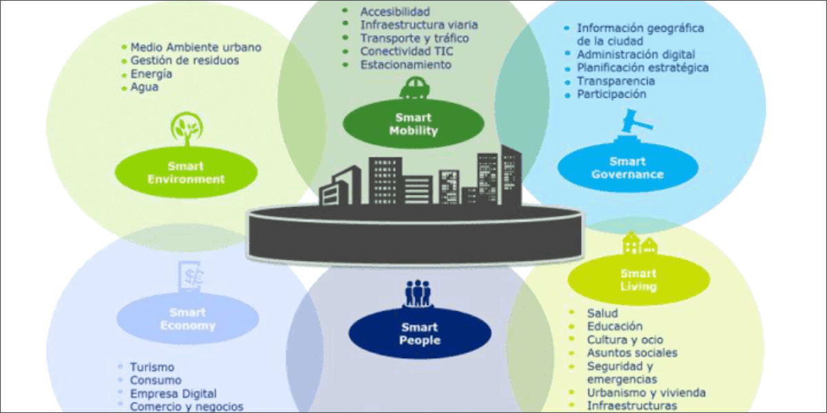
3. …. Smart cities
Concepts such as Smart Cities have emerged facilitated by the use of IoT, sensors and AI. Smart cities interpret the new information available through thousands of devices to facilitate the daily life of locals and visitors, by designing new forms of transport (smart mobility), environmental conservation, governance, economy, living, In a similar way, we could refer to smart destinations, smart health control, smart buildings, or smart energy systems.

Slide 11

4. What role for human beings in Digital Transformation?
The use of digital technologies is an integrating part of digital transformation, but it is not the only thing. It is also necessary to carry out the cultural transformations that digitization brings about, since it is a new way of living, working and relating; it is a cultural change produced by the current revolution, which is transforming society, business models and Administrations.
In the slides that follow, we are going to analyze:
The future of jobs in the digital economy
The changes that are taking place in the values and digital consumer behavior.

Slide 12
5. The future of jobs
The Digital Talent Gap. 90% of the jobs of the future will require digital skills, but there is a gap between supply and demand for digital talent that causes, for example, that 900,000 positions in Europe are not covered
We can already find job offers that we did not even imagine months ago, as drone pilots, cryptocurrency regulators, digital theft prevention and recovery officers, neuroimplants technicians, AI ethics specialists, etc.
It is impossible to predict what the jobs of the future will be. However, we can get ahead by understanding what the main skills, knowledge and work models.
SKILLS
Entrepreneurship, creativity, critical thinking, communication and negotiation, leadership, tolerance to change
KNOWLEDGE
holistic vision with logic, ethics, programming, technology, design, humanities. Ability of relating different knowledge areas to new activities to get an integrated and global vision.
EMPLOYMENT MODELS
Telework, work in projects, freelance work, start ups, flat organizations, multicultural environments
Notes:
Impact of technologies in employment
1.New technologies replace jobs.
2. New jobs related to innovation and IT
3. Consumption increase, expansion of other jobs.
4. Hybridization modifies tasks and requirements

Slide 13
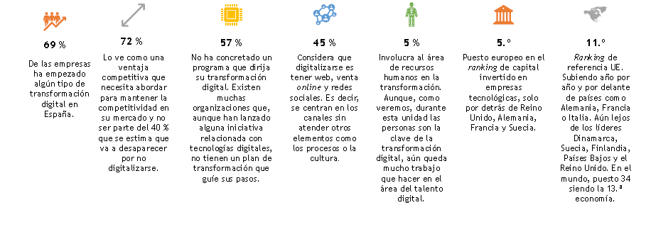
What about Spain?
Spain’s economic model based on cheap employment, with low qualifications and little concern for skill improvement, makes talent development one of the most difficult challenges to tackle in the face of digital transformation.
Although Spain holds the 5th European position in the ranking of capital invested in IT companies, and 11th in digitization, our country lags behind in terms of digital talent density. The index is 3 researchers and 7 developers for every 1000 inhabitants, a similar figure to that of countries such as Greece, Poland and Hungary. In contrast, Denmark has 8 researchers and 17 developers for every 1000 inhabitants. Here are some more numbers to define Digital Transformation in Spain:

Slide 14
6. The transformation of users
Customer relationships and user experience are key elements in the results of a company. When CEOs are asked about their priorities, in recent years a clear evolution can be observed from being concerned with the board of directors and shareholders to focusing on the customer. To compete in the global market and grow, companies require a greater and multidimensional understanding of their audiences.
Millennials, emerging markets and new digital consumer habits are causing a revolution in user behavior. How can a company focus on customers, if it doesn't understand customers’ new habits, motivations, attitudes and experiences?
Companies should take into account 9 trends in personal behaviors in their DT strategies:
Collaboration and cocreation
Do it yourself.
User power
Customization
“Liquid modernity” (rapid change). Instant apps, slacktivism
Hybrid experience (online and offline). AR, VR, MR. Post-it app, Ikea catalogue
Immediate response. UbeRUSH, store pick-up
Transparency. People, companies, public administration
Effortless.

Slide 15
References
The next normal arrives: Trends that will define 2021—and beyond. (n.d.). Retrieved from https://www.mckinsey.com/featured-insights/leadership/the-next-normal-arrives-trends-that-will-define-2021-and-beyond#
Gartner. (2020). Gartner Top Strategic Technology Trends for 2021. Smarter with Gartner. Retrieved from https://www.gartner.com/smarterwithgartner/gartner-top-strategic-technology-trends-for-2021/
Horii, B. M., & Sakurai, Y. (2020). The future of work in Japan: Accelerating automation after COVID-19, (June), 1–9.
Manyika, J., Chui, M., & Bughin, J. (2013). Disruptive technologies: Advances that will transform life, business, and the global economy. McKinsey Global …, (May), 163. Retrieved from http://www.mckinsey.com/insights/business_technology/disruptive_technologies%5Cnhttp://www.chrysalixevc.com/pdfs/mckinsey_may2013.pdf
World Economic Forum. (2020). The Future of Jobs Report 2020. Research Report. Retrieved from https://www.weforum.org/reports/the-future-of-jobs-report-2018%0Ahttp://reports.weforum.org/future-of-jobs-2016/shareable-infographics/%0Ahttp://reports.weforum.org/future-of-jobs-2016/chapter-1-the-future-of-jobs-and-skills/%0Ahttps://www.weforum.org/rep

